Slide 1

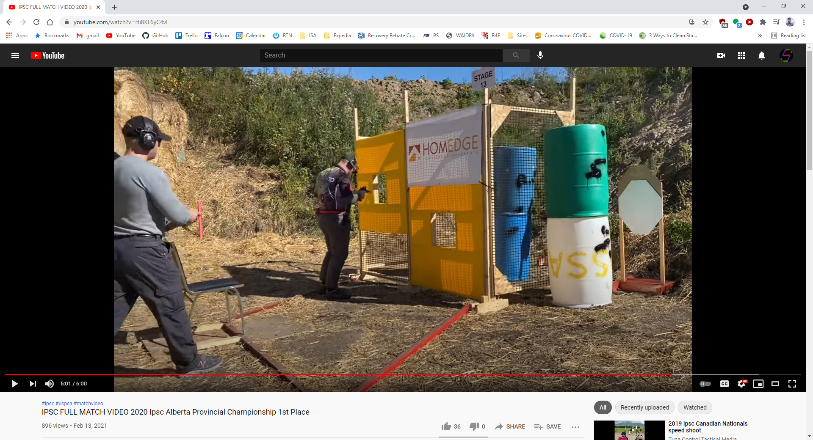
 | Renton Fish and Game Bay x Gopher Hunting Course Designer: Name
START POSITION:
STAGE PROCEDURE: At the start signal, |  | SCORING: Comstock, 23 rounds, 115 points TARGETS: 10 metric, 3 Steel SCORED HITS: Best 2 per paper, Steel must fall START-STOP: Audible - Last shot
Muzzle safe cone
T1
PP1
P1
T2
P2
T3
P3
T4
P4
T5
P5
T6
P6
T7
T8
T9
start
A

Slide 2
X
X
X
Out & Back Target
Drop Out Shoot
Drop Out Shoot
Drop Out Penalty
Drop Out Penalty
Flop-Up
Flop-Up
Can-Can Array
USP2
PP2
USP1
Flop-Up
Flop-Up
PP1
T10
Plate Flop-Up
Plate Flop-Up

Slide 3


Free Fire Zone

Slide 4
Walls with see-thru ports
PORT COVER, copy and paste to cover or change size of see-thru ports
Ungroup this wall, then click above, below, left or right of the port and resize the opening, then group the object again.

Slide 5
Walls with see-thru doorways & removable doors
Copy and paste, resize or edit points of this panel to cover or change a see thru doorway.
Doors- copy and paste these to make a door wall.

Slide 6
Setup Notes:
P3 and related area should be pushed far into the kink of the bay. T1 is as far back on the right as possible while maintaining safe berm impacts
Target Requirements:
1x Standard Target
2x Tuxedo Target
2x Headshot Target
2x Upper Torso Target
2x Lower Torso Target
3x Non-Threat

